Slide 1

E-Commerce Website
Medi-Caps University
A presentation
Submitted in partial fulfillment of requirement of the Degree of
BACHELOR OF TECHNOLOGY
in
COMPUTER SCIENCE AND ENGINEERING
BY
Naman Gupta (EN18CS301154)

Slide 2
Content
Company Profile
Introduction
Scope of Project
Features
Technology Description
Graphical User Interface(GUI)
Landing Page/ Home Page
Catalog
Product Details
Login
Signup
Cart
Payment

Slide 3
Company Profile
Tata Consultancy Services is an Indian multinational information technology services and consulting company headquartered in Mumbai, Maharashtra, India with its largest campus located in Chennai, Tamil Nadu, India. As of February 2021, TCS is the largest IT services company in the world by market capitalization.
They provide various services like:
Web Development
Mobile Development
Python Development
AI based applications
MEAN stack Development etc.
The Corporate Identification Number (CIN) of Tata Consultancy Services Limited is L22210MH1995PLC084781. The registered office of Tata Consultancy Services Limited is at 9th Floor Nirmal Building, Nariman Point Mumbai.

Slide 4
Certificate

Slide 5
ShopDeck

Slide 6
Introduction
An eCommerce website is an information technology method in which traders, businesses/distributors/marketers can sell products/services and the customer can purchase on that website electronically by using the internet on the mobile and computer. It means an e-commerce website is an online shop. e means electronic. Commerce means business. Website means the group of HTML web pages and that is created to market/sell information/product/services.
From a bigger perspective, every website on the internet is the eCommerce Website. It can be the platform, it can be a marketplace, it can be a portal, it can be apps, it can be an entertainment website, shopping website, online courses website and online degree college.

Slide 7
Objective
We are designing an e-Commerce website which will show the basic features like login, signup, home etc. using ReactJs technology.
A front-end project which focuses only on the designing and navigating through the pages.
Creating a user-friendly design.

Slide 8
Scope of Project
The scope of the project will be limited to some functions of the e-commerce website. It will display products, customers can select catalogs and select products, and can view products in their cart specifying the quantity of each item. Selected items will be collected in a cart.
At checkout, the item on the cart will be presented as an order. Customers can pay for the items in the cart to complete an order. This project has great future scope. The project also provides security with the use of login ID and passwords, so that no unauthorized users can access your account. The only authorized person who has the appropriate access can access the software.

Slide 9
Limitations
Focused only on designing and navigation.
No back-end database is added.
Basic Functionality is shown.
Currently only accessed via a browser.

Slide 10
FEATURES
SIGN-UP
LOGIN
CATEGORY
PRODUCTS
CART
PAYMENT
The new user have to create account on the website through sign-up information required from the user like email, phone number , password , name, address etc.
The user credentials are typically some form of username and a matching password, and these credentials themselves are sometimes referred to as login.
The user can apply filter according to their needs.
HOME
The upcoming and the newly launched products will appear here.
The homepage is often the highest traffic page on an e-commerce site. This single page is responsible for building trust, driving sales, and creating lifelong customers
You can add and remove items as you wish, just like you would in the real world.
CHECKOUT
This includes the choices to pay for the products.
This includes every step that a customer goes through to proceed through to checkout.

Slide 11
Technology Description
ReactJS–
React is a free and open-source front-end JavaScript library for building user interfaces based on UI components. It is maintained by Meta and a community of individual developers and companies.
CSS-
Cascading Style Sheets is a style sheet language used for describing the presentation of a document written in a markup language such as HTML. CSS is a cornerstone technology of the World Wide Web, alongside HTML and JavaScript.
Firebase-
Firebase is a platform developed by Google for creating mobile and web applications. It was originally an independent company founded in 2011. In 2014, Google acquired the platform and it is now their flagship offering for app development.

Slide 12
Technology Description
React-router-dom
Styled-components
Styled-components is a popular library that is used to style React applications. It allows you to build custom components by writing actual CSS in your JavaScript.
React Router DOM is an npm package that enables you to implement dynamic routing in a web app. It allows you to display pages and allow users to navigate them. It is a fully-featured client and server-side routing library for React.

Slide 13
Design and Diagrams

Slide 14
Use case Diagram
Represent the dynamic behavior of a system.
Encapsulates system's functionality.
It models tasks, services, and functions of application.
Recognizes the internal and external factors that influence the system.
It represents the interaction between the actors.

Slide 15
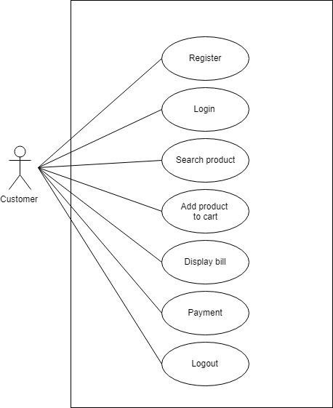
Use-Case Diagram

Slide 16
State-Chart Diagram
The State-Chart diagram is used to demonstrate the flow of control within the system rather than the implementation. It models the concurrent and sequential activities.
The State-Chart diagram helps in envisioning the workflow from one activity to another. It put emphasis on the condition of flow and the order in which it occurs. The flow can be sequential, branched, or concurrent, and to deal with such kinds of flows, the activity diagram has come up with a fork, join, etc.
It is also termed as an object-oriented flowchart. It encompasses activities composed of a set of actions or operations that are applied to model the behavioral diagram.

Slide 17
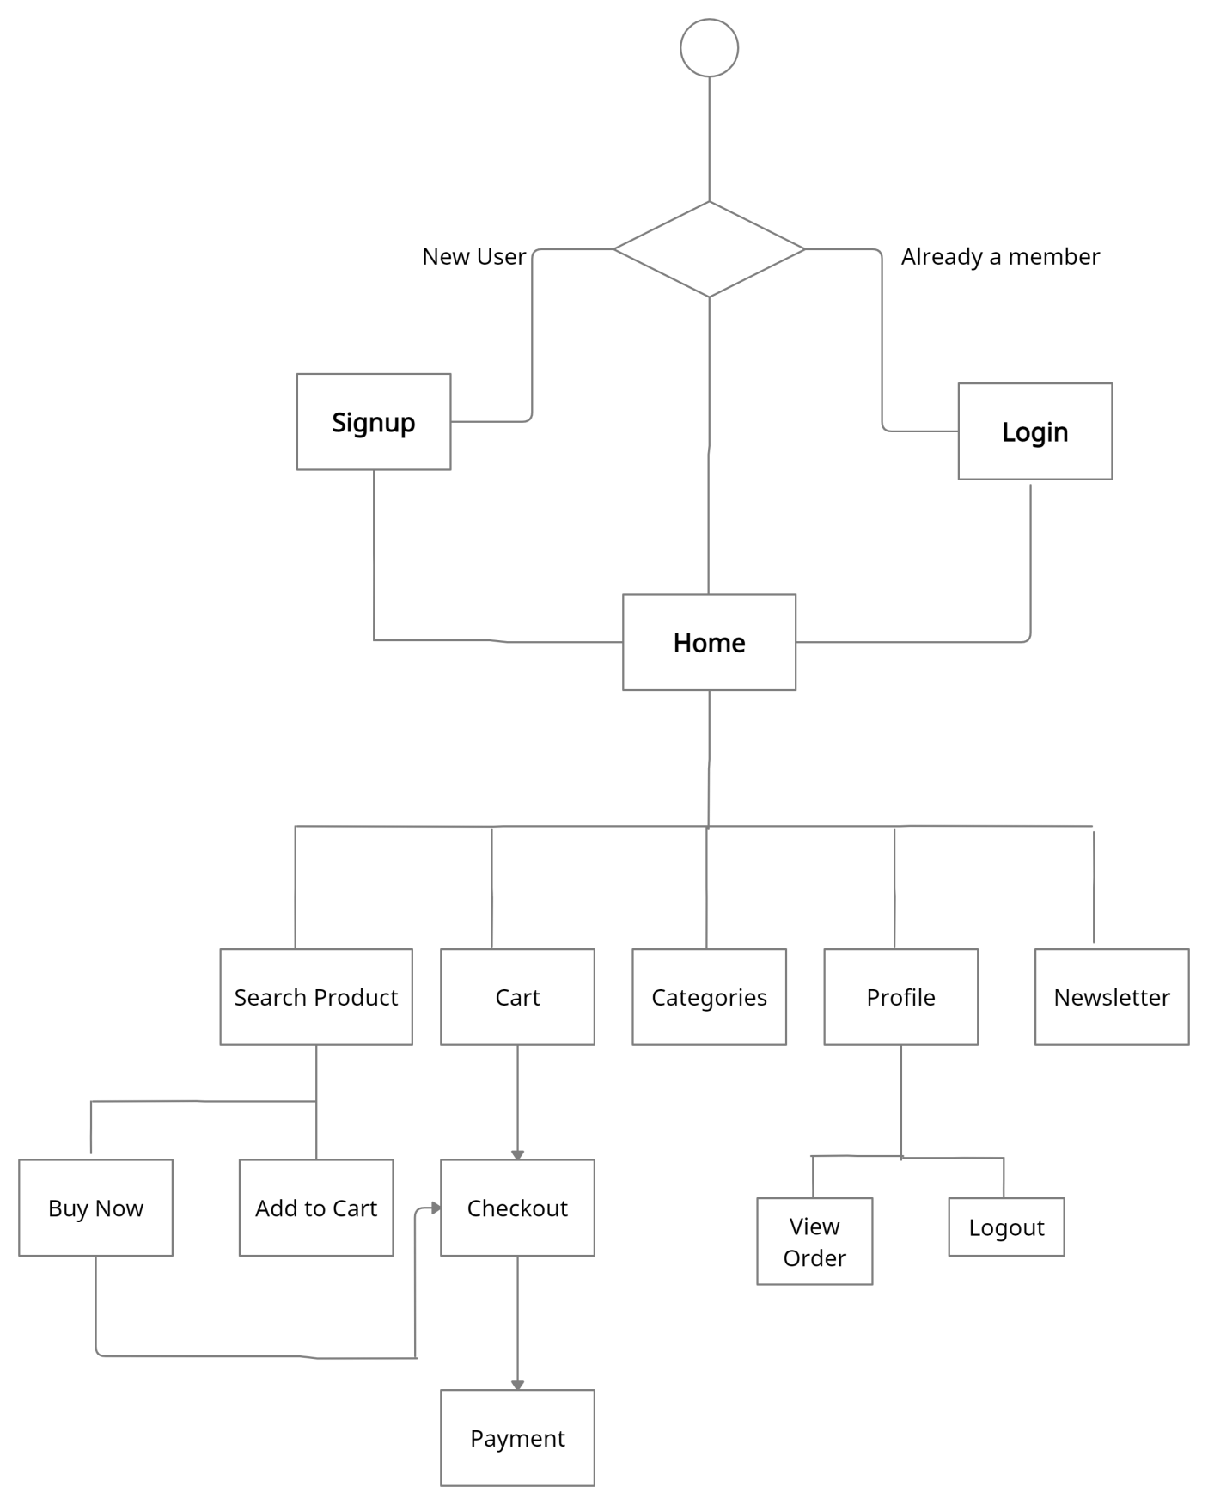
State-Chart Diagram

Slide 18
Graphical User Interface(GUI)

Slide 19
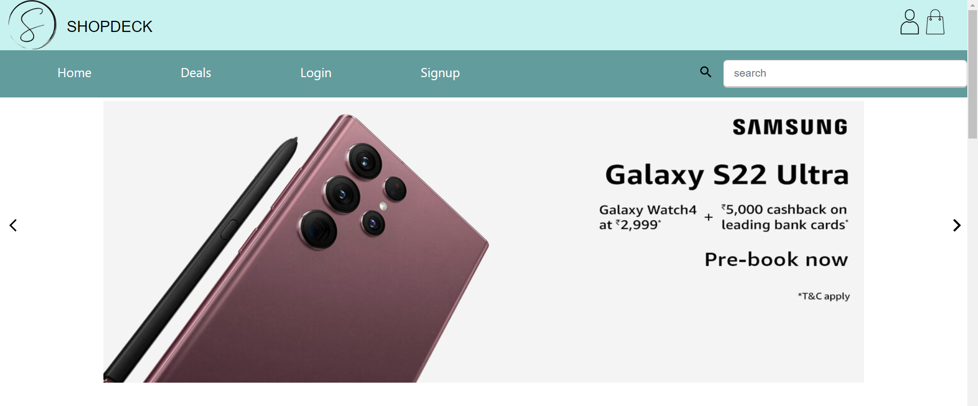
Landing Page/ Home Page

Slide 20
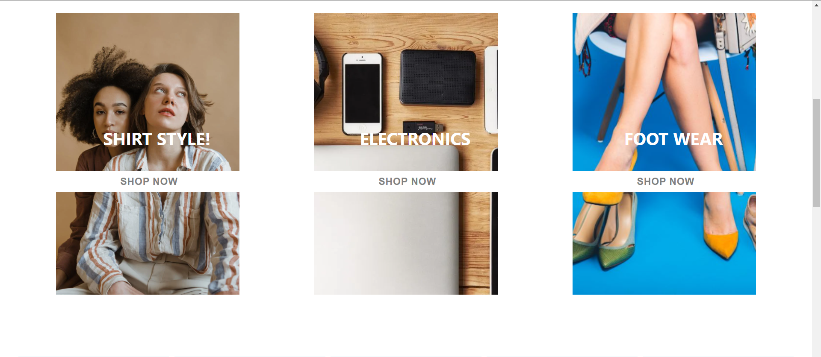
Home Page(cont.)

Slide 21
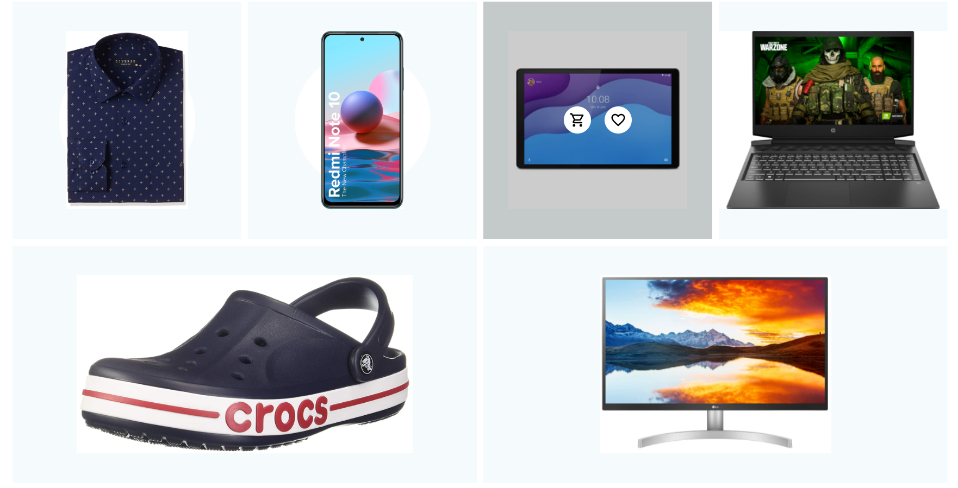
Home Page(Cont.)

Slide 22
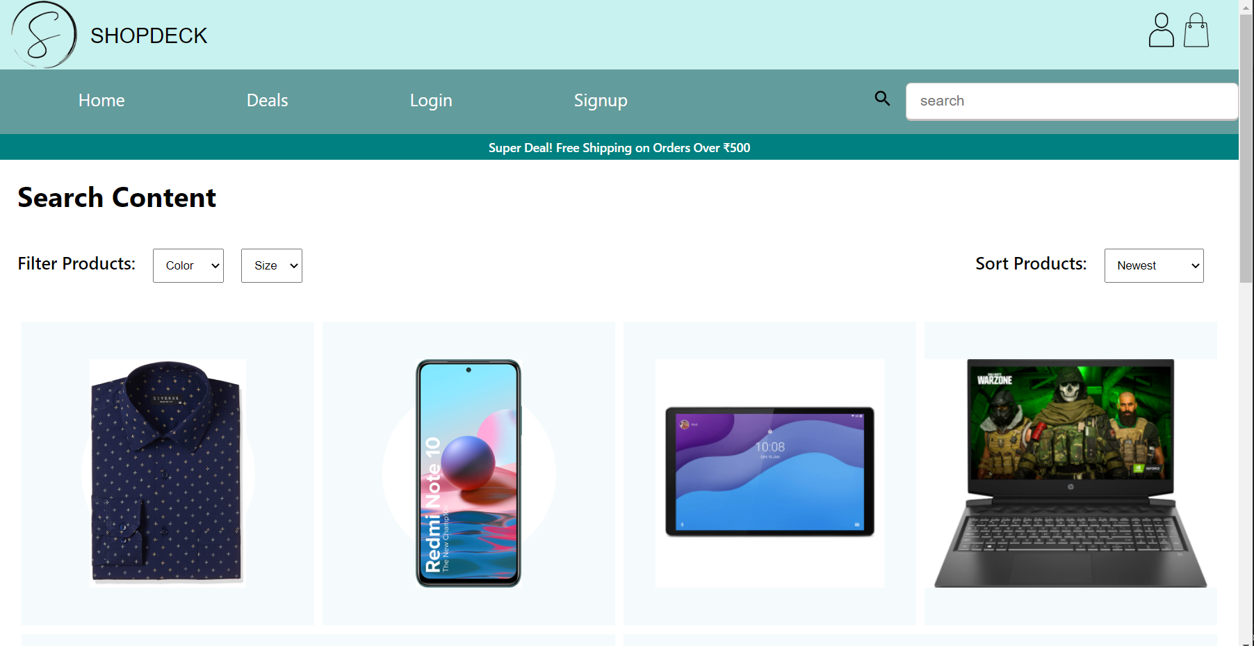
Catalog

Slide 23
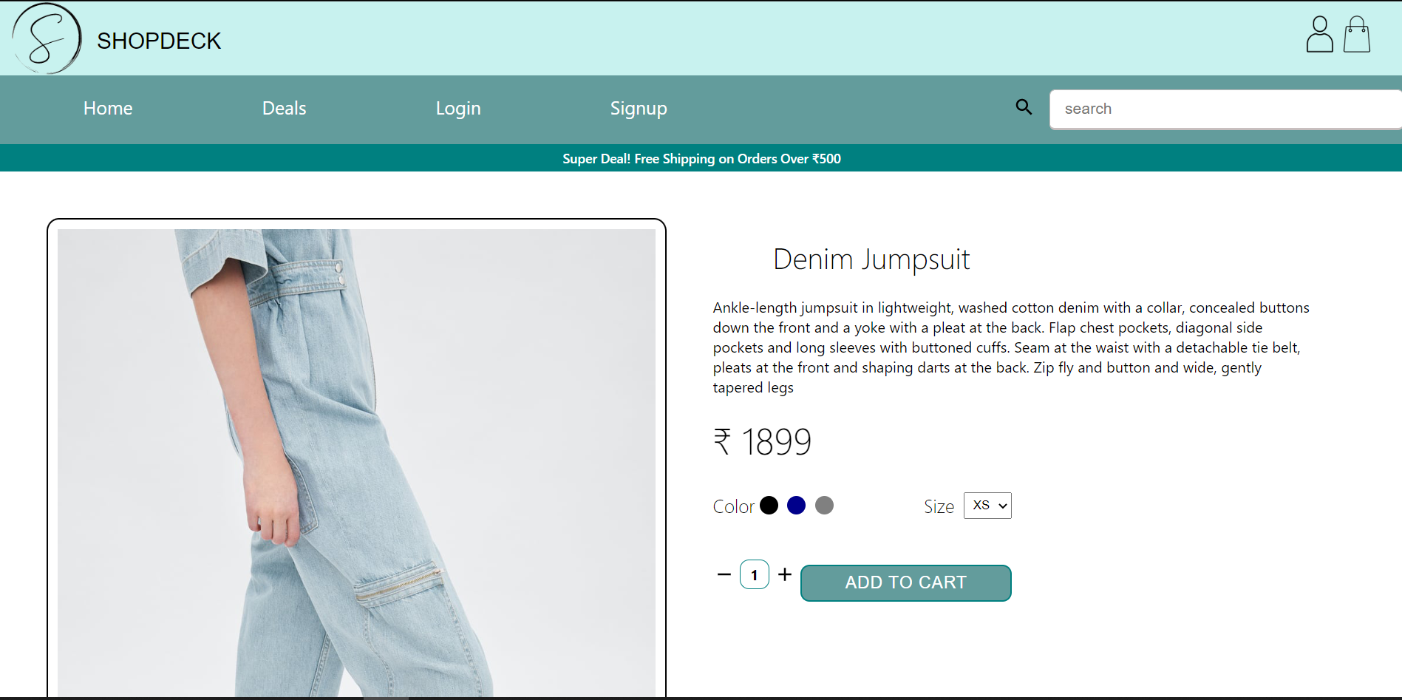
Product Details

Slide 24
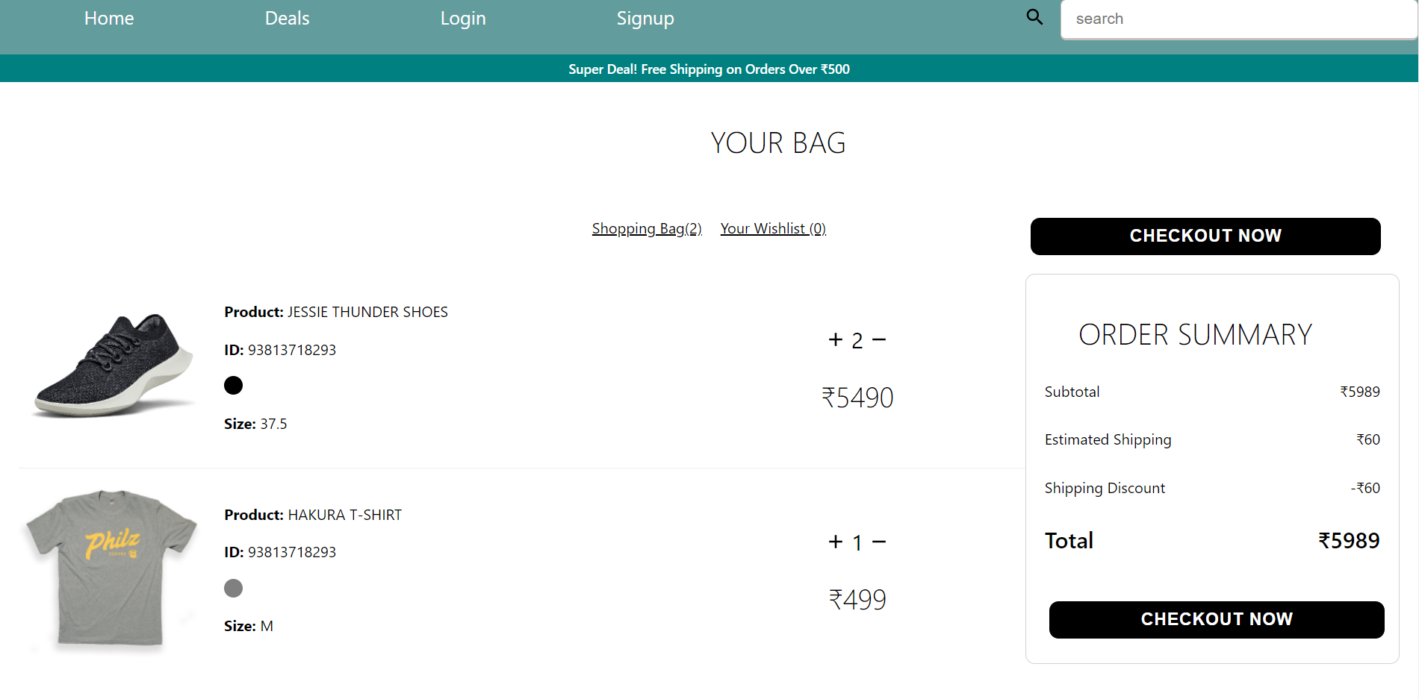
Cart

Slide 25
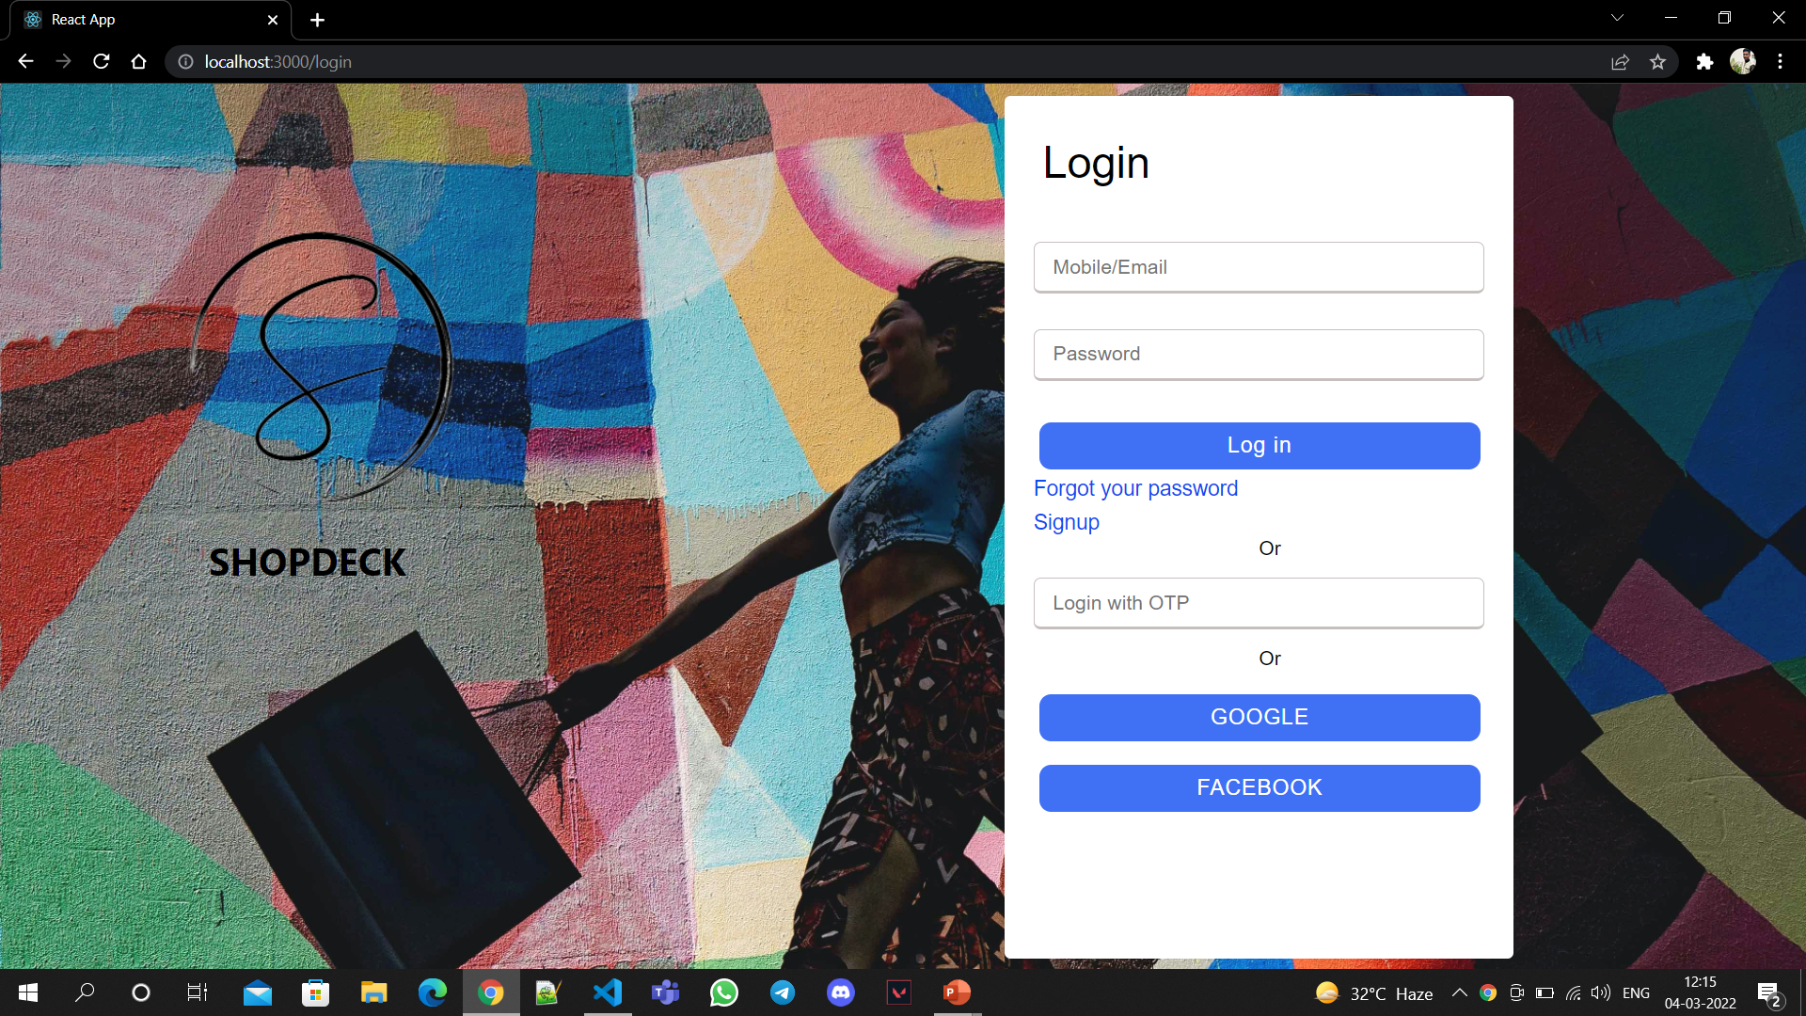
Login

Slide 26
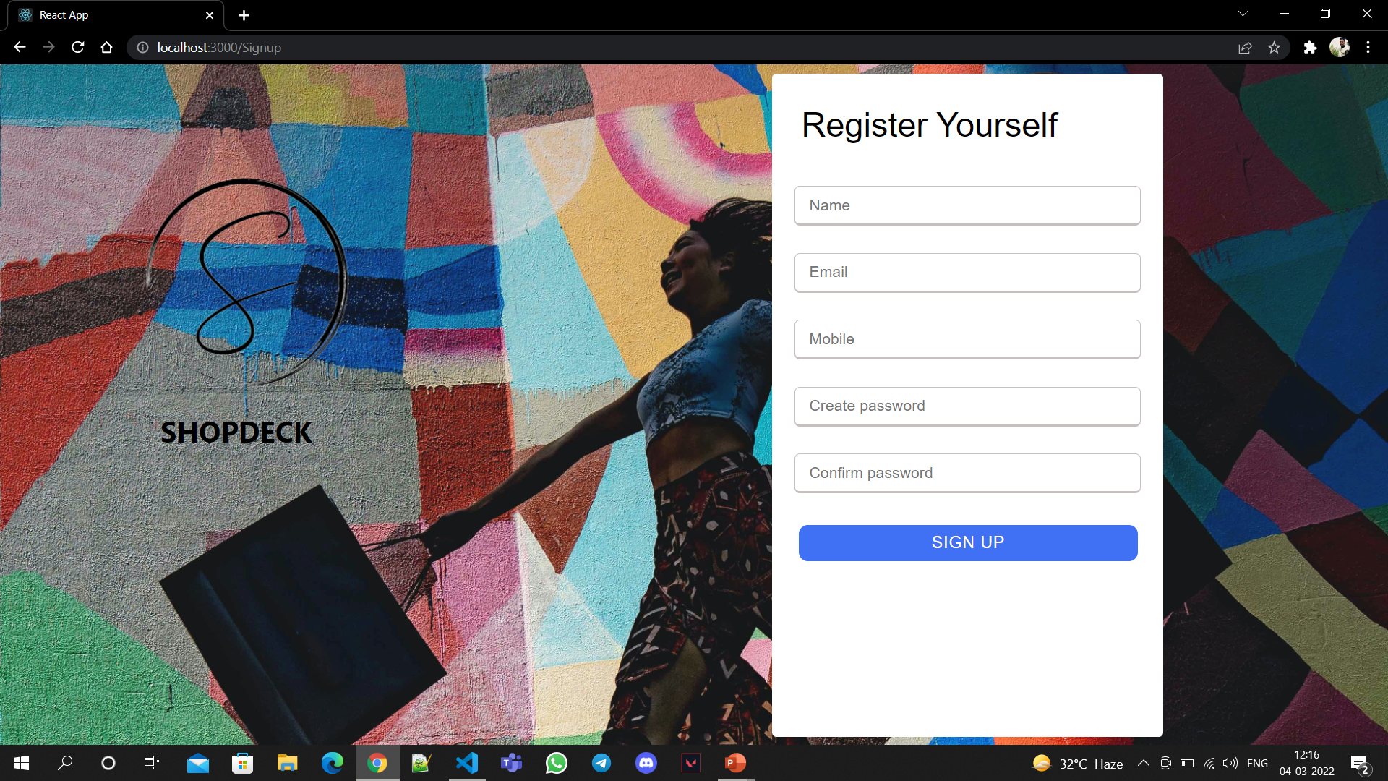
Signup

Slide 27
References
https://reactjs.org/docs/getting-started.html
https://www.geeksforgeeks.org/javascript/
https://www.javascript.com/learn/strings
https://code.visualstudio.com/docs
https://firebase.google.com/docs/firestore

Slide 28
Thankyou

